Slide 1
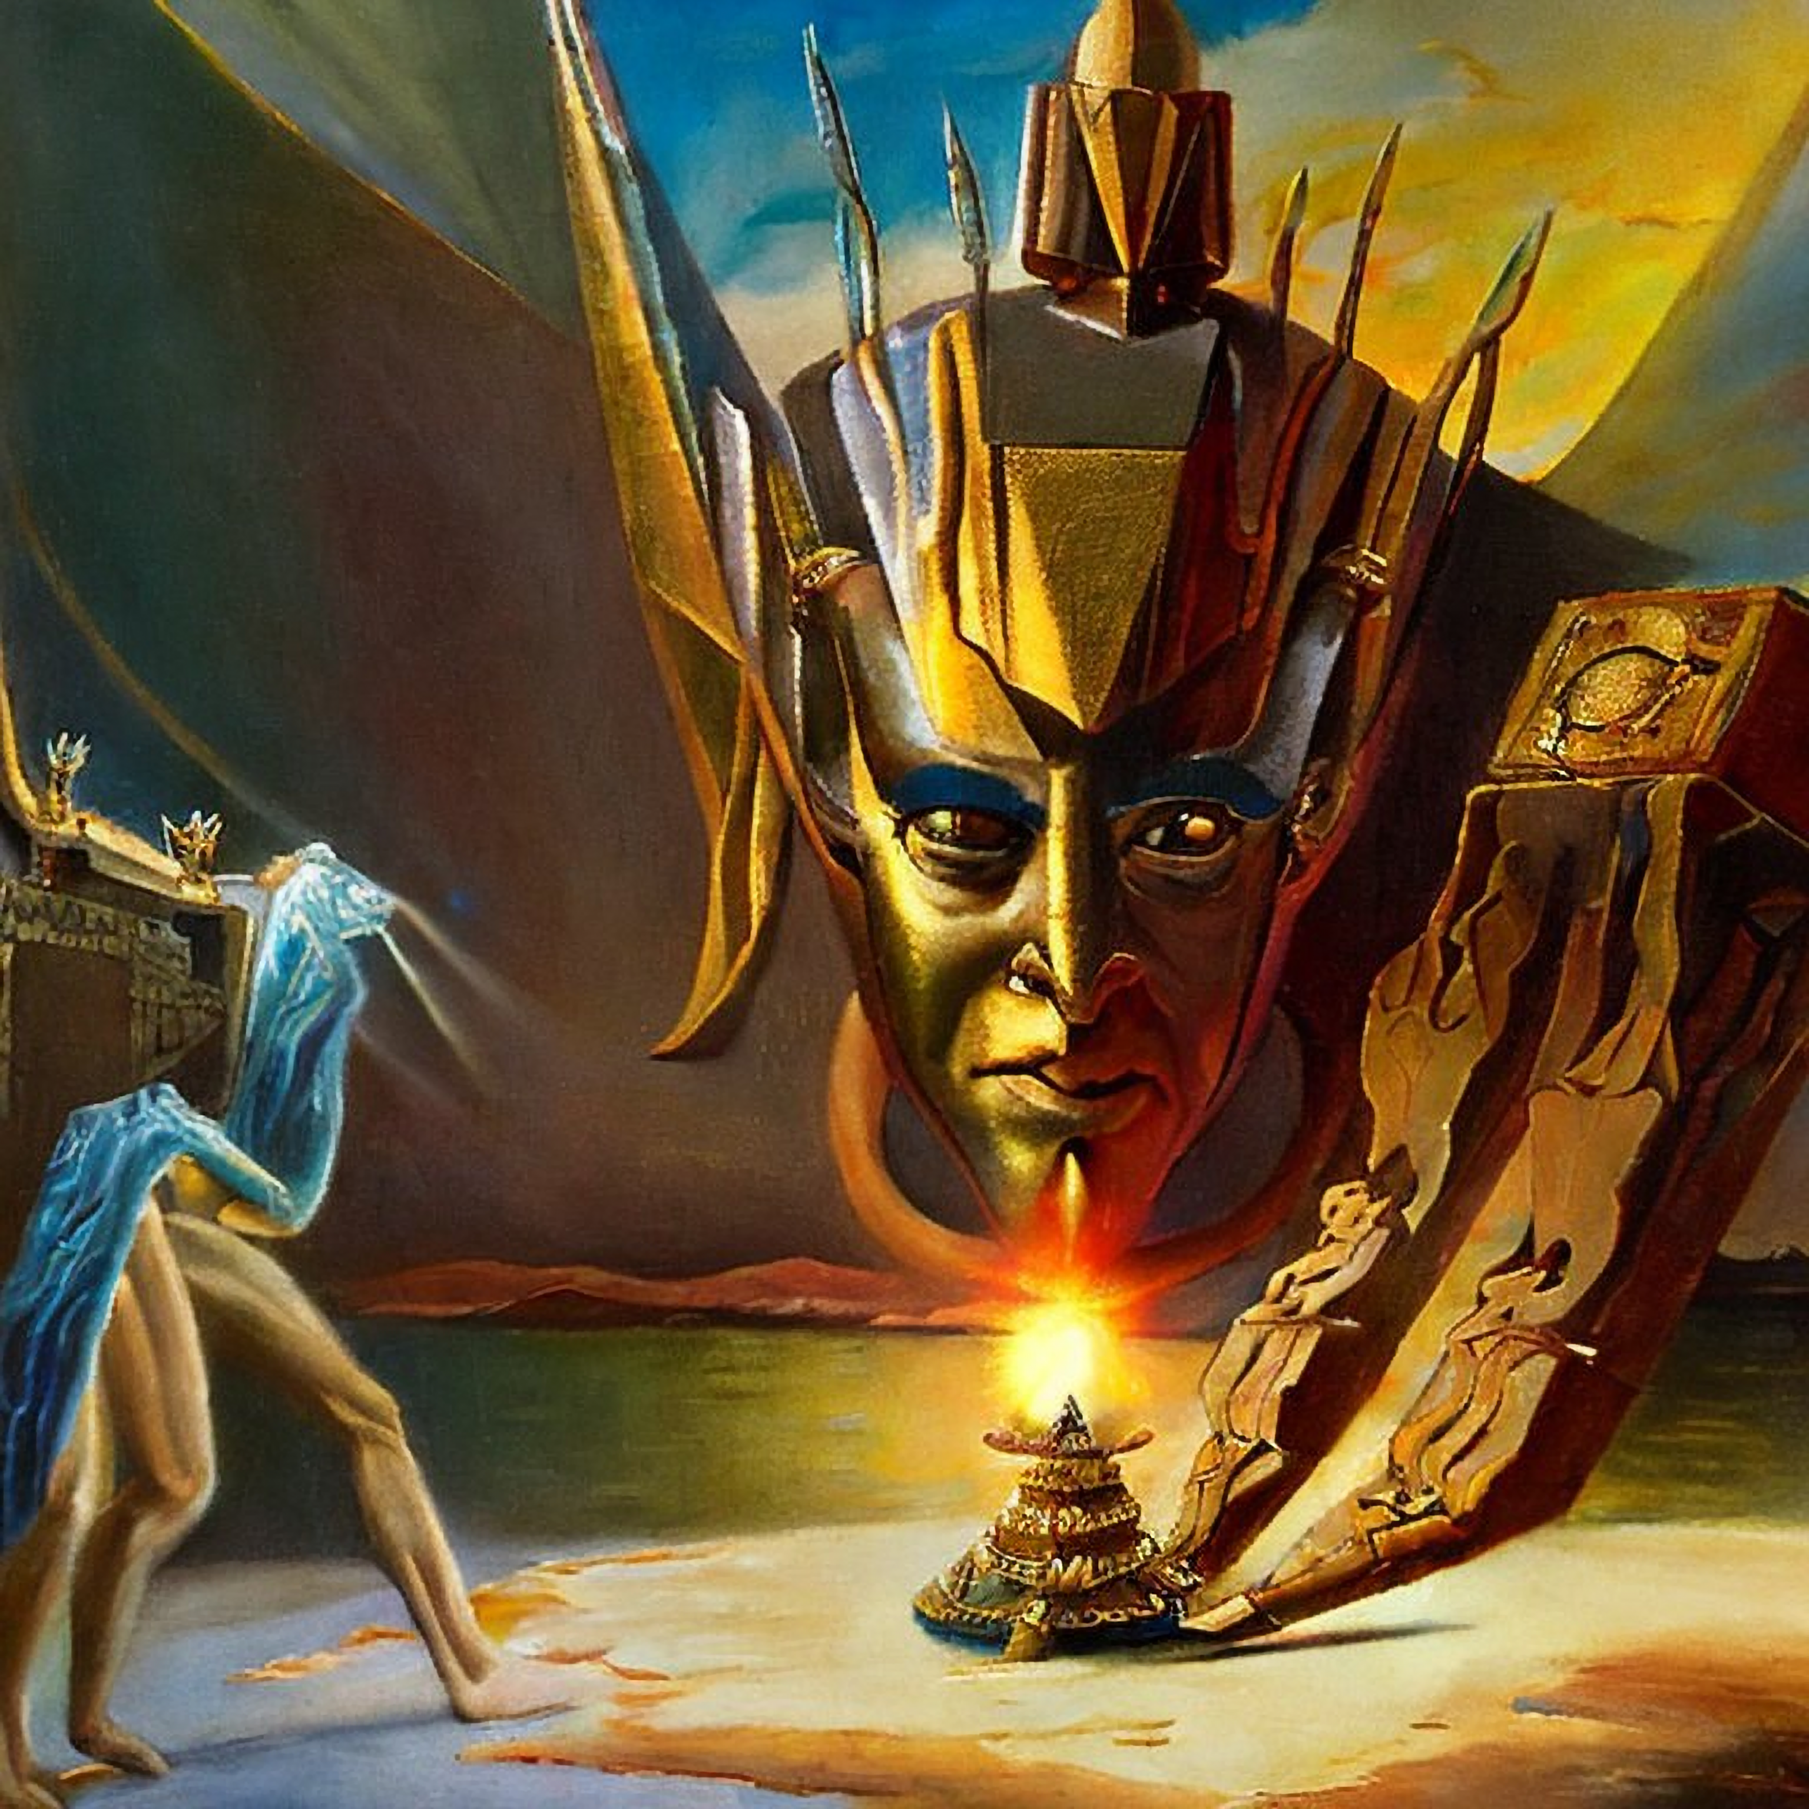
The Call of the Transformer
generated with Stable Diffusion 2.1

Slide 2
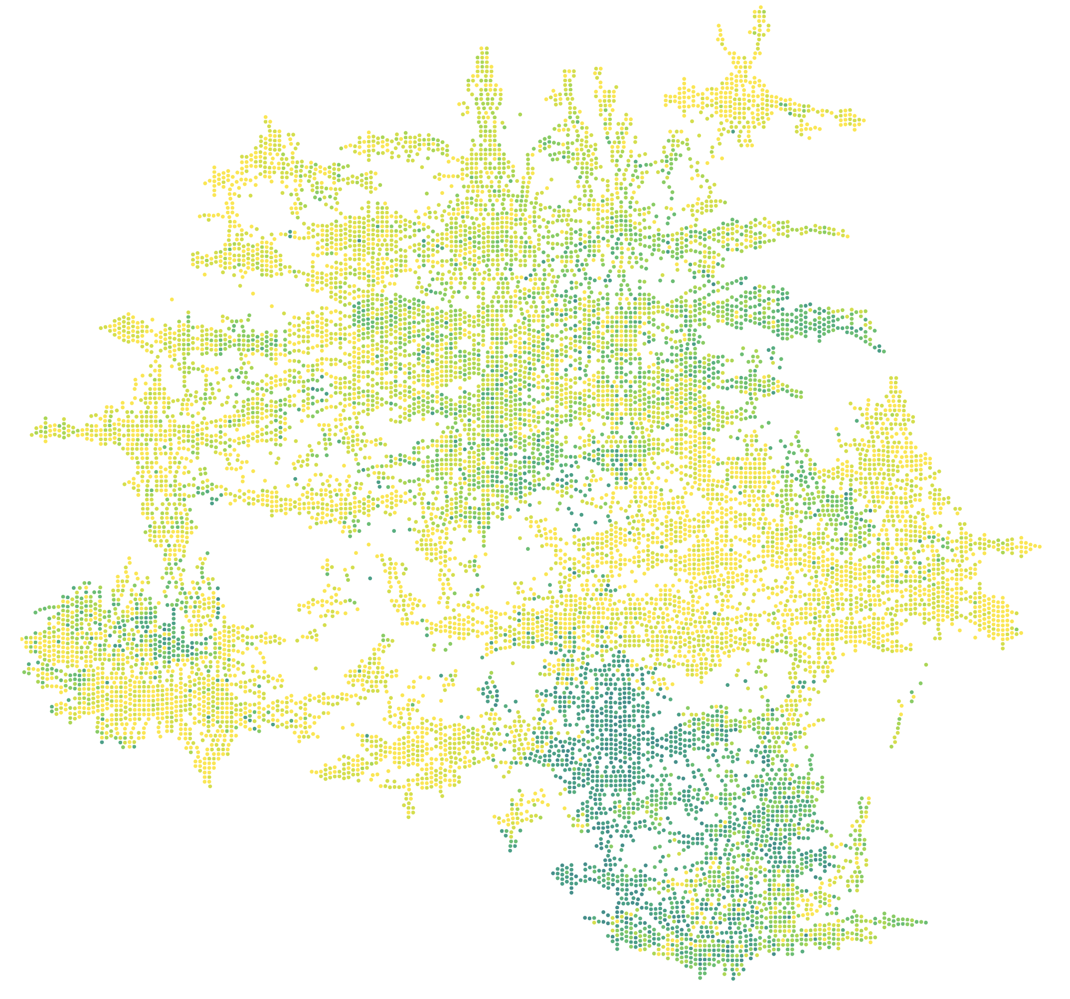

NEURIPS map
https://neuripsav.vizhub.ai/
we will be somewhere around here

Slide 3
Why solving language?
“The limits of my language mean the limits of my world.”
*
Ludwig Wittgenstein
* there’s a lot going on here as he was a somehow controversial fellow; assume we treat his words out of context

Slide 4
Shannon’s Guessing Game
Prediction and Entropy of Printed English, 1951
RATHER DRAMATICALLY THE OTHER DAY
–––HER––––MATICAL–––T–––OTH––––AY

Slide 5
Redundancy
Aoccdrnig to rscheearch at Cmabirgde Uinervtisy, it deosn’t mttaer in waht oredr the ltteers in a wrod are, the olny iprmoetnt tihng is taht the frist and lsat ltteer be at the rghit pclae. The rset can be a ttoal mses and you can sitll raed it wouthit porbelm. Tihs is bcuseae the huamn mnid deos not raed ervey lteter by istlef, but the wrod as a wlohe. Amzanig huh?

Slide 6
Data-to-Information Ratio
Rules exist, but they get drowned by noise!

Slide 7
It’s all statistics
(but not clever statistics)
“With four parameters I can fit an elephant, and with five I can make him wiggle his trunk.”
John von Neumann

Slide 8
It’s all statistics
(but not clever statistics)
The causes of data don’t lie in the data.
The Book of Why, Judea Pearl

Slide 9
Interlude
“You cannot answer a question that you cannot ask, and you cannot ask a question that you have no words for.”
Judea Pearl

Slide 10
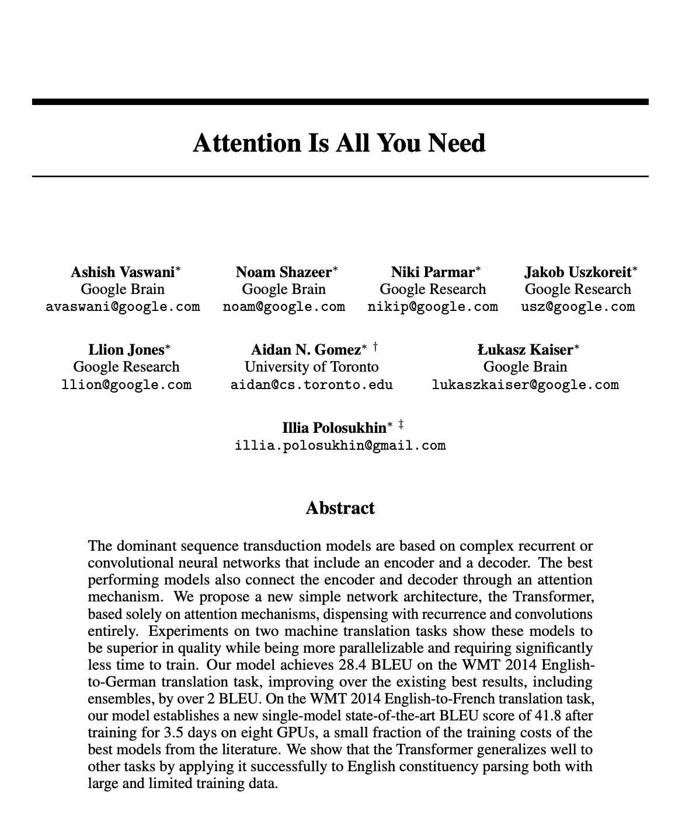
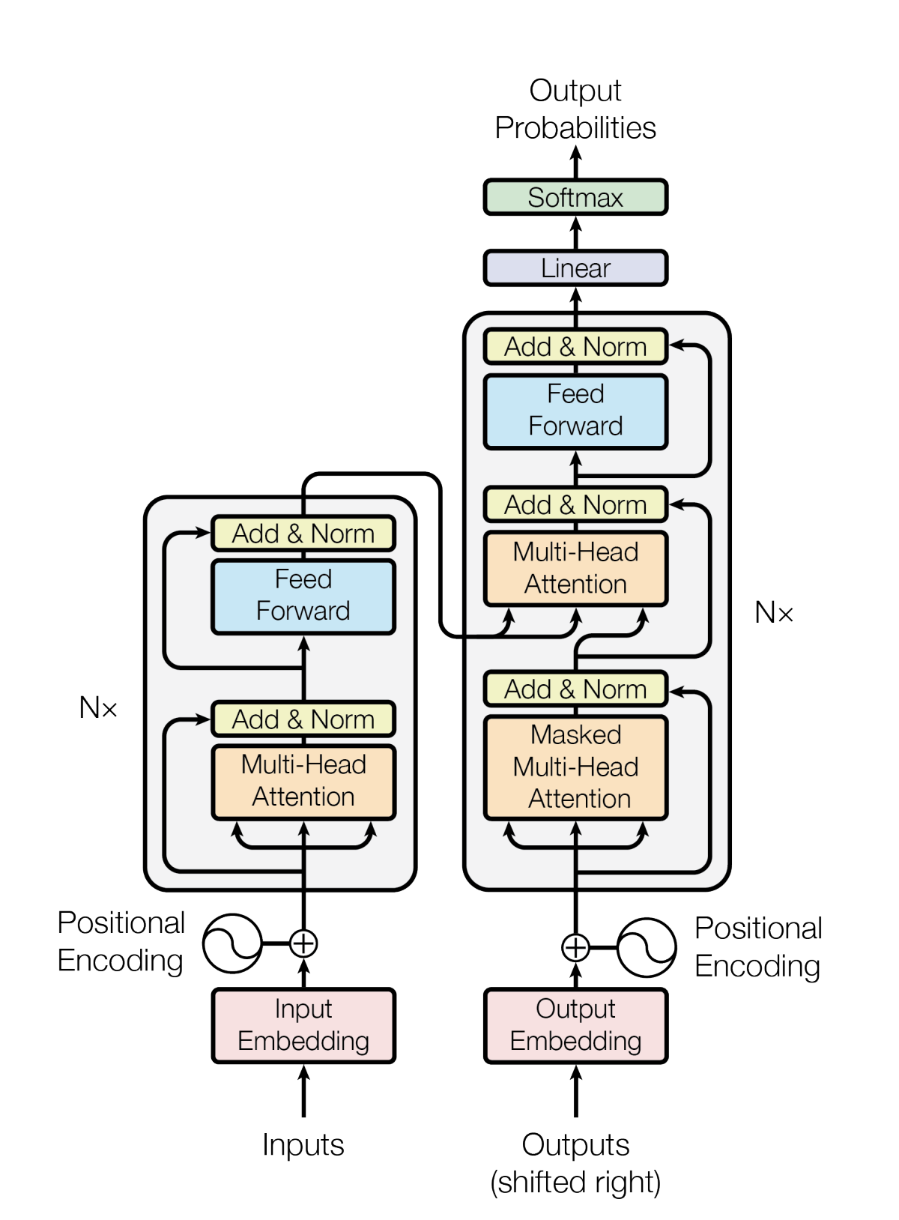

Transformer
we will focus on these

Slide 11
Attention
Why queries, keys, and values?
DATABASE
$$(k_{1},v_{1})$$
$$(k_{2},v_{2})$$
$$(k_{3},v_{3})$$
$$(k_{4},v_{4})$$
$$q$$
hit
$$(k_{5},v_{5})$$
$$(k_{6},v_{6})$$

Slide 12
Attention
brief seq2seq (encoder-decoder) background
hidden state
$$y_{1}$$
$$y_{2}$$
$$y_{3}$$
input sequence is compressed into a single fixed-length vector representation
the decoder sees the same representation of the input at every time step
the state is not able to cope with long-term dependencies
$$x_{1}$$
$$x_{2}$$
$$x_{3}$$

Slide 13


Attention
self-attention
cross-attention
DATABASE
$$(k_{1},v_{1})$$
$$(k_{2},v_{2})$$
$$(k_{3},v_{3})$$
$$(k_{4},v_{4})$$
$$(k_{5},v_{5})$$
$$(k_{6},v_{6})$$

Slide 14
Attention
single-head
multi-head
$$(k_{6},v_{6})$$

Slide 15
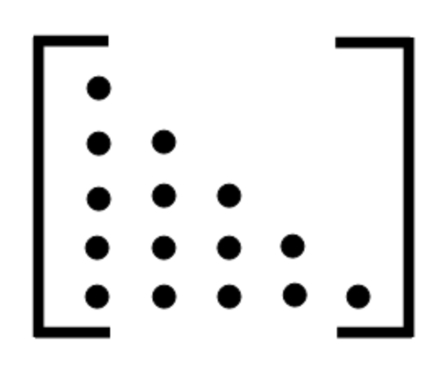
Attention
non-masked
masked
0

Slide 16
Attention
Input
Hello
world
Embedding
Queries
Keys
Values
Scores
24
20
Divide by $\sqrt{3}$
14
12
Softmax
0.88
0.12
$×$ Values
Context

Slide 17

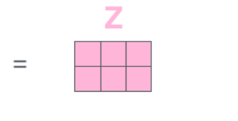
Attention

Slide 18
Interlude
”The Transformer is a magnificent neural network architecture because it is a general-purpose differentiable computer.”
Andrej Karpathy

Slide 19
Status Quo
huggingface/transformers
174 models

Slide 20

Language Models
Autoregressive
Autoencoding
THE CAT SITS ON THE[…]
THE […] SITS ON THE SOFA.
GPT
BERT

Slide 21
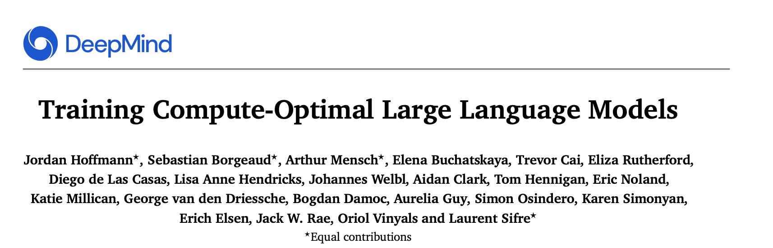
Scaling Laws
Given a specific compute budget, how big of a model should we train and for how many tokens?

Slide 22
The Players
Chinchilla
PaLM
MT-NLG
Gopher
GPT3
LaMDA
2022
2022
2021
2021
2020
2022
70B
540B
530B
280B
175B
137B

Slide 23
The Law
$$L(N,D)=\frac{A}{N^{α}}+\frac{B}{D^{β}}+E$$
irreducible
finite model
finite dataset

Slide 24
The Law
Constants for the MassiveText dataset: 10.5 TB of text
$$L(N,D)=\frac{406.4}{N^{0.34}}+\frac{410.7}{D^{0.28}}+1.69$$

Slide 25
The Law
nostalgebraist, chinchilla's wild implications

Slide 26
The Law
1.993
-0.057
1.936
-0.012
1.924
nostalgebraist, chinchilla's wild implications

Slide 27
The Law
1.924
-0.074
1.85
nostalgebraist, chinchilla's wild implications

Slide 28
The Law
x4.7
x9.2
nostalgebraist, chinchilla's wild implications

Slide 29
Data
nostalgebraist, chinchilla's wild implications

Slide 30
Future
relating multiple texts to each other
numbers and math
a notion of time
rare events
data hunger

Slide 31
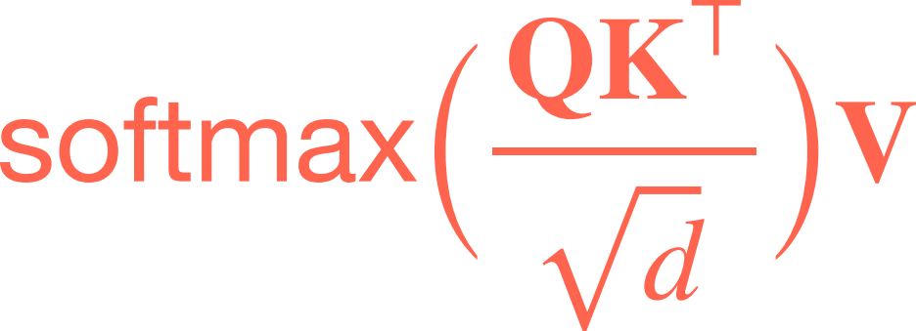
Thanks for your

